Slide 1




DIGITAL LITERACY
SKILLS
INTERMEDIATE USERS

Slide 2
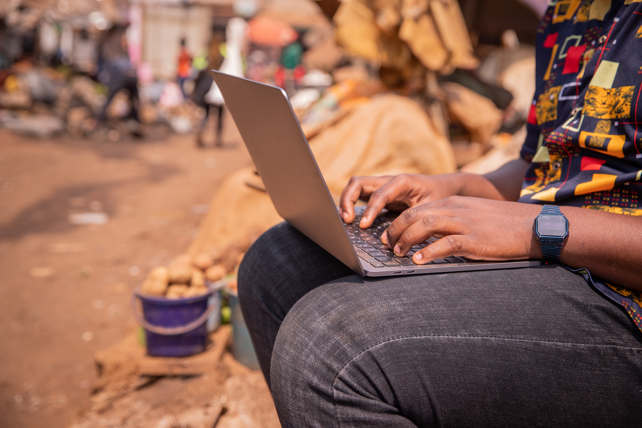
Module 3
Communication
and collaboration

Slide 3

3
Unit 3: Engaging in citizenship through digital technologies

Slide 4
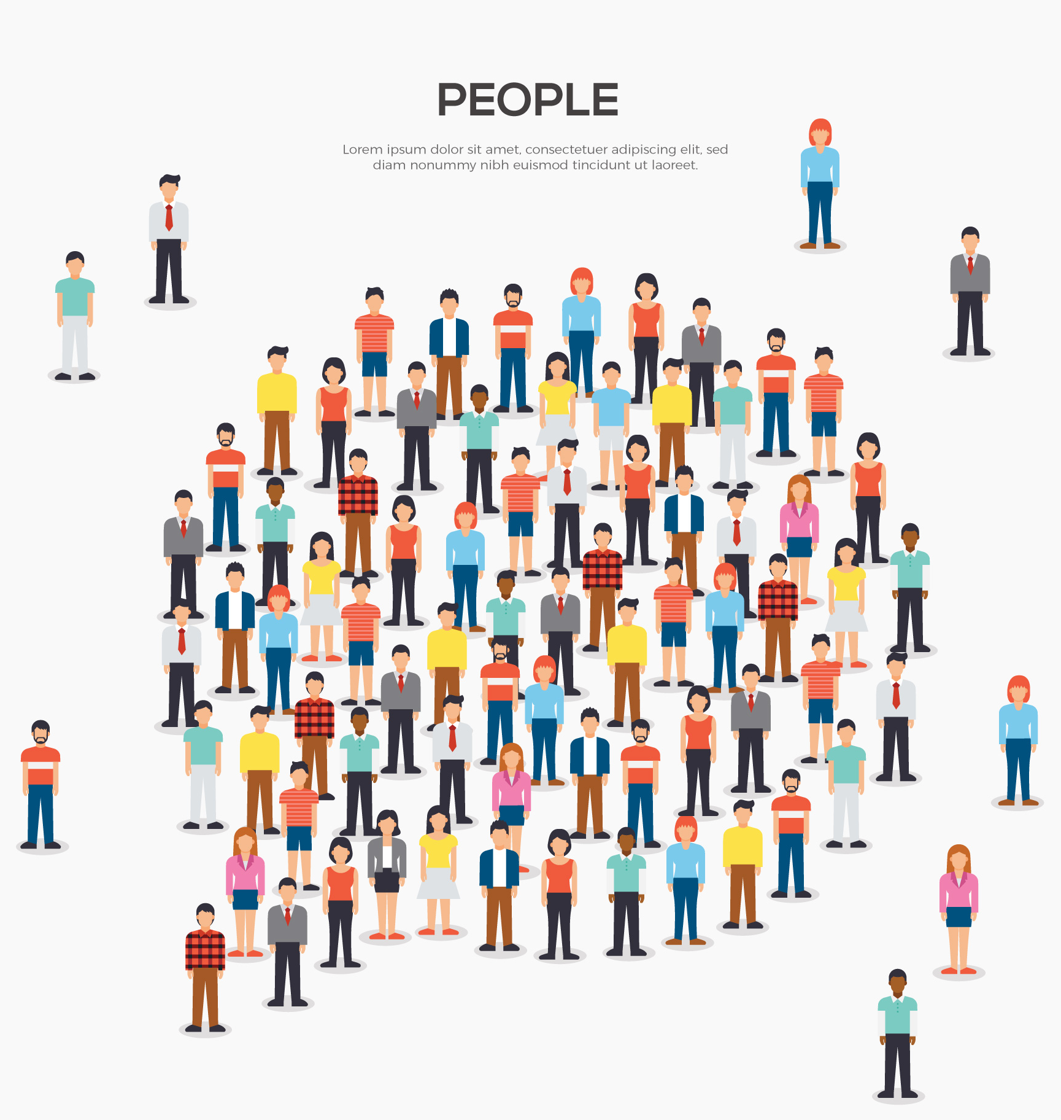
Basic concepts of digital citizenship
E-Safety: Includes internet privacy and how behaviour can add to healthy interactions.
Reputation: How we are perceived online.
Relationships: Using technology to interact with others.
Ethics: How to act in an ethical way online.

Slide 5
Digital citizenship
A good citizen |  | A good digital citizen
Advocates for equal human rights |  | Advocates for equal digital rights for all
Treats others with respect |  | Seeks to understand all perspectives
Does not steal or damage others’ property |  | Respects digital privacy, intellectual property, and other rights of people online
Communicates clearly respectfully and with empathy |  | Communicates and acts with empathy for others’ humanity via digital channels
Speaks honestly and does not repeat unsubstantiated rumours |  | Applies critical thinking to all online sources, including fake news
Protects self and others from harm |  | Is mindful of physical, emotional, and mental health while using digital tools.
Projects a positive self-image |  | Understands the permanence of the digital world and proactively manages their digital identity

Slide 6
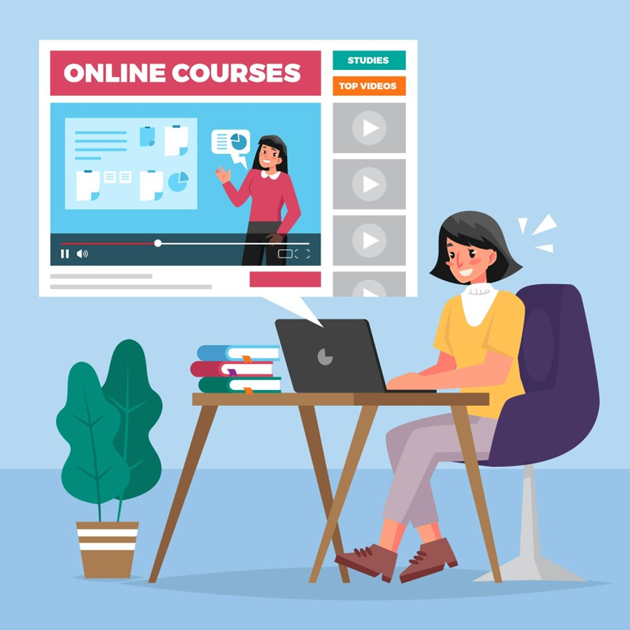
Online training and eLearning
Online teaching and training services take many forms.
Some advertise the services they offer at their premises, whereas others offer online training and e-learning.

Slide 7
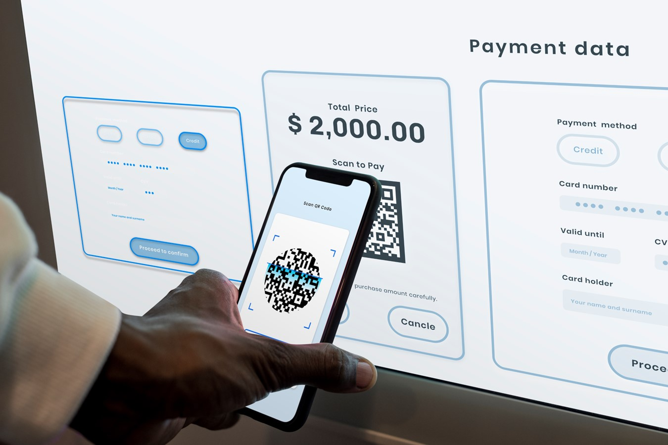
Features of online services
Online public services
Online banking
Online shopping

Slide 8
Guidelines for interacting with online services
1
2
3
Ensure that the site is safe
Ensure that the payment methods on the site are authentic
Ensure that you find out about the online services before you register.

Slide 9
Skills to practice
Use features of online services.
Open National Geographic Kids (https://kids.nationalgeographic.com/).
Select a topic that you would like to learn about.
Follow the lessons.
Play one of the games.
Use digital technology to create a solution.
Assume that your school does not have enough drinking water for students.
Use the internet to research and propose a solution to the problem.
Use your digital skills to set out a proposal.

Slide 10
Skills to practice
3. Become involved online in social issues.
Do a Google search or social media search for groups in your area that are involved in solving social issues.
Choose one group that you are interested in.
If the group uses social media, follow the group, and post your opinion on an issue.
Find out if the group is active in a project that helps others, join the project if you can.

Slide 11
All back covers should include
contact information of the section
producing the work.
© United Nations Children’s Fund (UNICEF) [month and year of publication]

